Slide 1
Spectrophotometric Method Development and Validation for Application in Occupational Exposure Assessment of Trichloroethylene.
by
Lerato Monatisa
Intern Medical Scientist: MSIN 0006718
Analytical Services
NIOH Research day
30 November 2022
Healthy, Safe, Happy & Sustainable Workplaces
PROMOTING DECENT WORK THROUGH CUTTING EDGE RESEARCH, SPECIALISED SERVICES, INFORMATION, TEACHING AND TRAINING

Slide 2
INTRODUCTION
Need for the development of an alternative Method
1
Selective method for TCE
2
Existing methods may be too contamination prone, too expensive, time consuming, or energy intensive
3
No method available

Slide 3
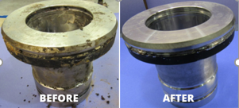
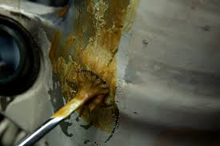
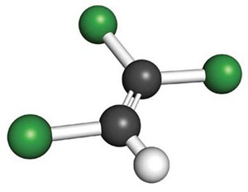
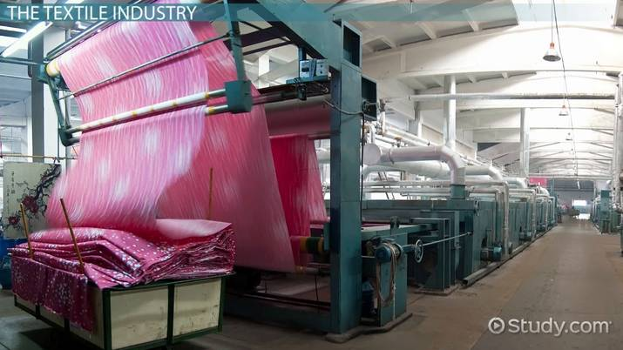
INTRODUCTION
Grease from metal parts
Paint removers
Trichloroethylene (TCE)
Dry-cleaning facilities
Textile industries

Slide 4
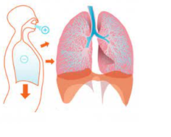
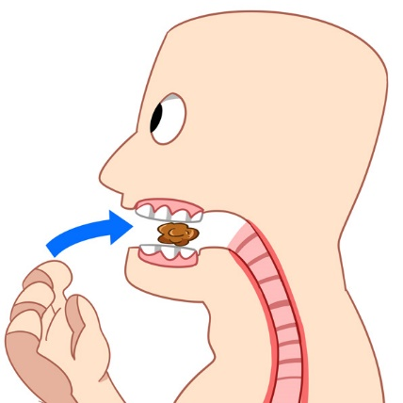
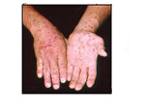
INTRODUCTION CONT’D
Exposure route:
Inhalation
Ingestion
Dermal Exposure
Biological Exposure Index (ACCIH,2019)
15 mg/L (114 mol/L)

Slide 5
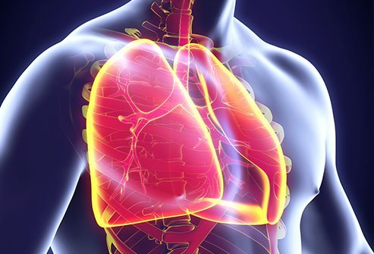
LITERATURE REVIEW
Health effects of TCE
Fatigue ^{2,3,4}
Confusion ^{2,3,4}
Central nervous system⁴
Reproductive system⁴
Acute
Chronic
Headache^{2,3}
cardiovascular system
Sleepiness ^{2,3,4}
Pulmonary system^{4,5}
Blurred vision ^{2,3,4}
Cancer^{4,5}

Slide 6
LITERATURE REVIEW CONT’D
Analytical methods for the determination of TCE
Author | Matrix | Sample preparation | Separation and Detection | LOD/LOQ (ng/ml)
Munch and Hautma., 1995 (EPA) | Water | LLE | GC-ECD | 1
Brown et al., 2003 | Tissues (livers, kidney, lungs) | LLE | GC-MS | 5
Liu et al.,2007 | blood, liver, lung, kidney and brain | HS-SPME | GC- MS | 0.25 and 0.75
Rastkari, N., Ahmadkhaniha, R., & Yunesian, M. (2012) | Urine | SPME | GC-MS | 0.005
Zhang, M., & Harrington, P. (2015) | Water | LLME–SPME | GC-MS | Not reported
GC: Gas Chromatography LLE: Liquid-Liquid Extraction
ECD: Electron Capture Detector HS-SPME: Head Space-Solid Phase Microextraction Phase
MS: Mass spectroscopy LLME: Liquid-Liquid Microextraction
G]]]g

Slide 7
PROBLEM STATEMENT
An analytical method suitable for routine analysis
The issues
The resolution
The outcome
TCE is a Toxic VOC: occupational Hazard
Current methods are expensive
Employing spectrophotometric technique

Slide 8
AIM AND OBJECTIVES
Aim
To develop and validate an analytical spectrophotometric method for application in occupational exposure assessment of trichloroethylene.
Objectives
To develop and validate a method for the routine analysis of TCE in human urine using UV-Vis spectrophotometry.
To increase the scope of tests offered in the Analytical Services department.

Slide 9
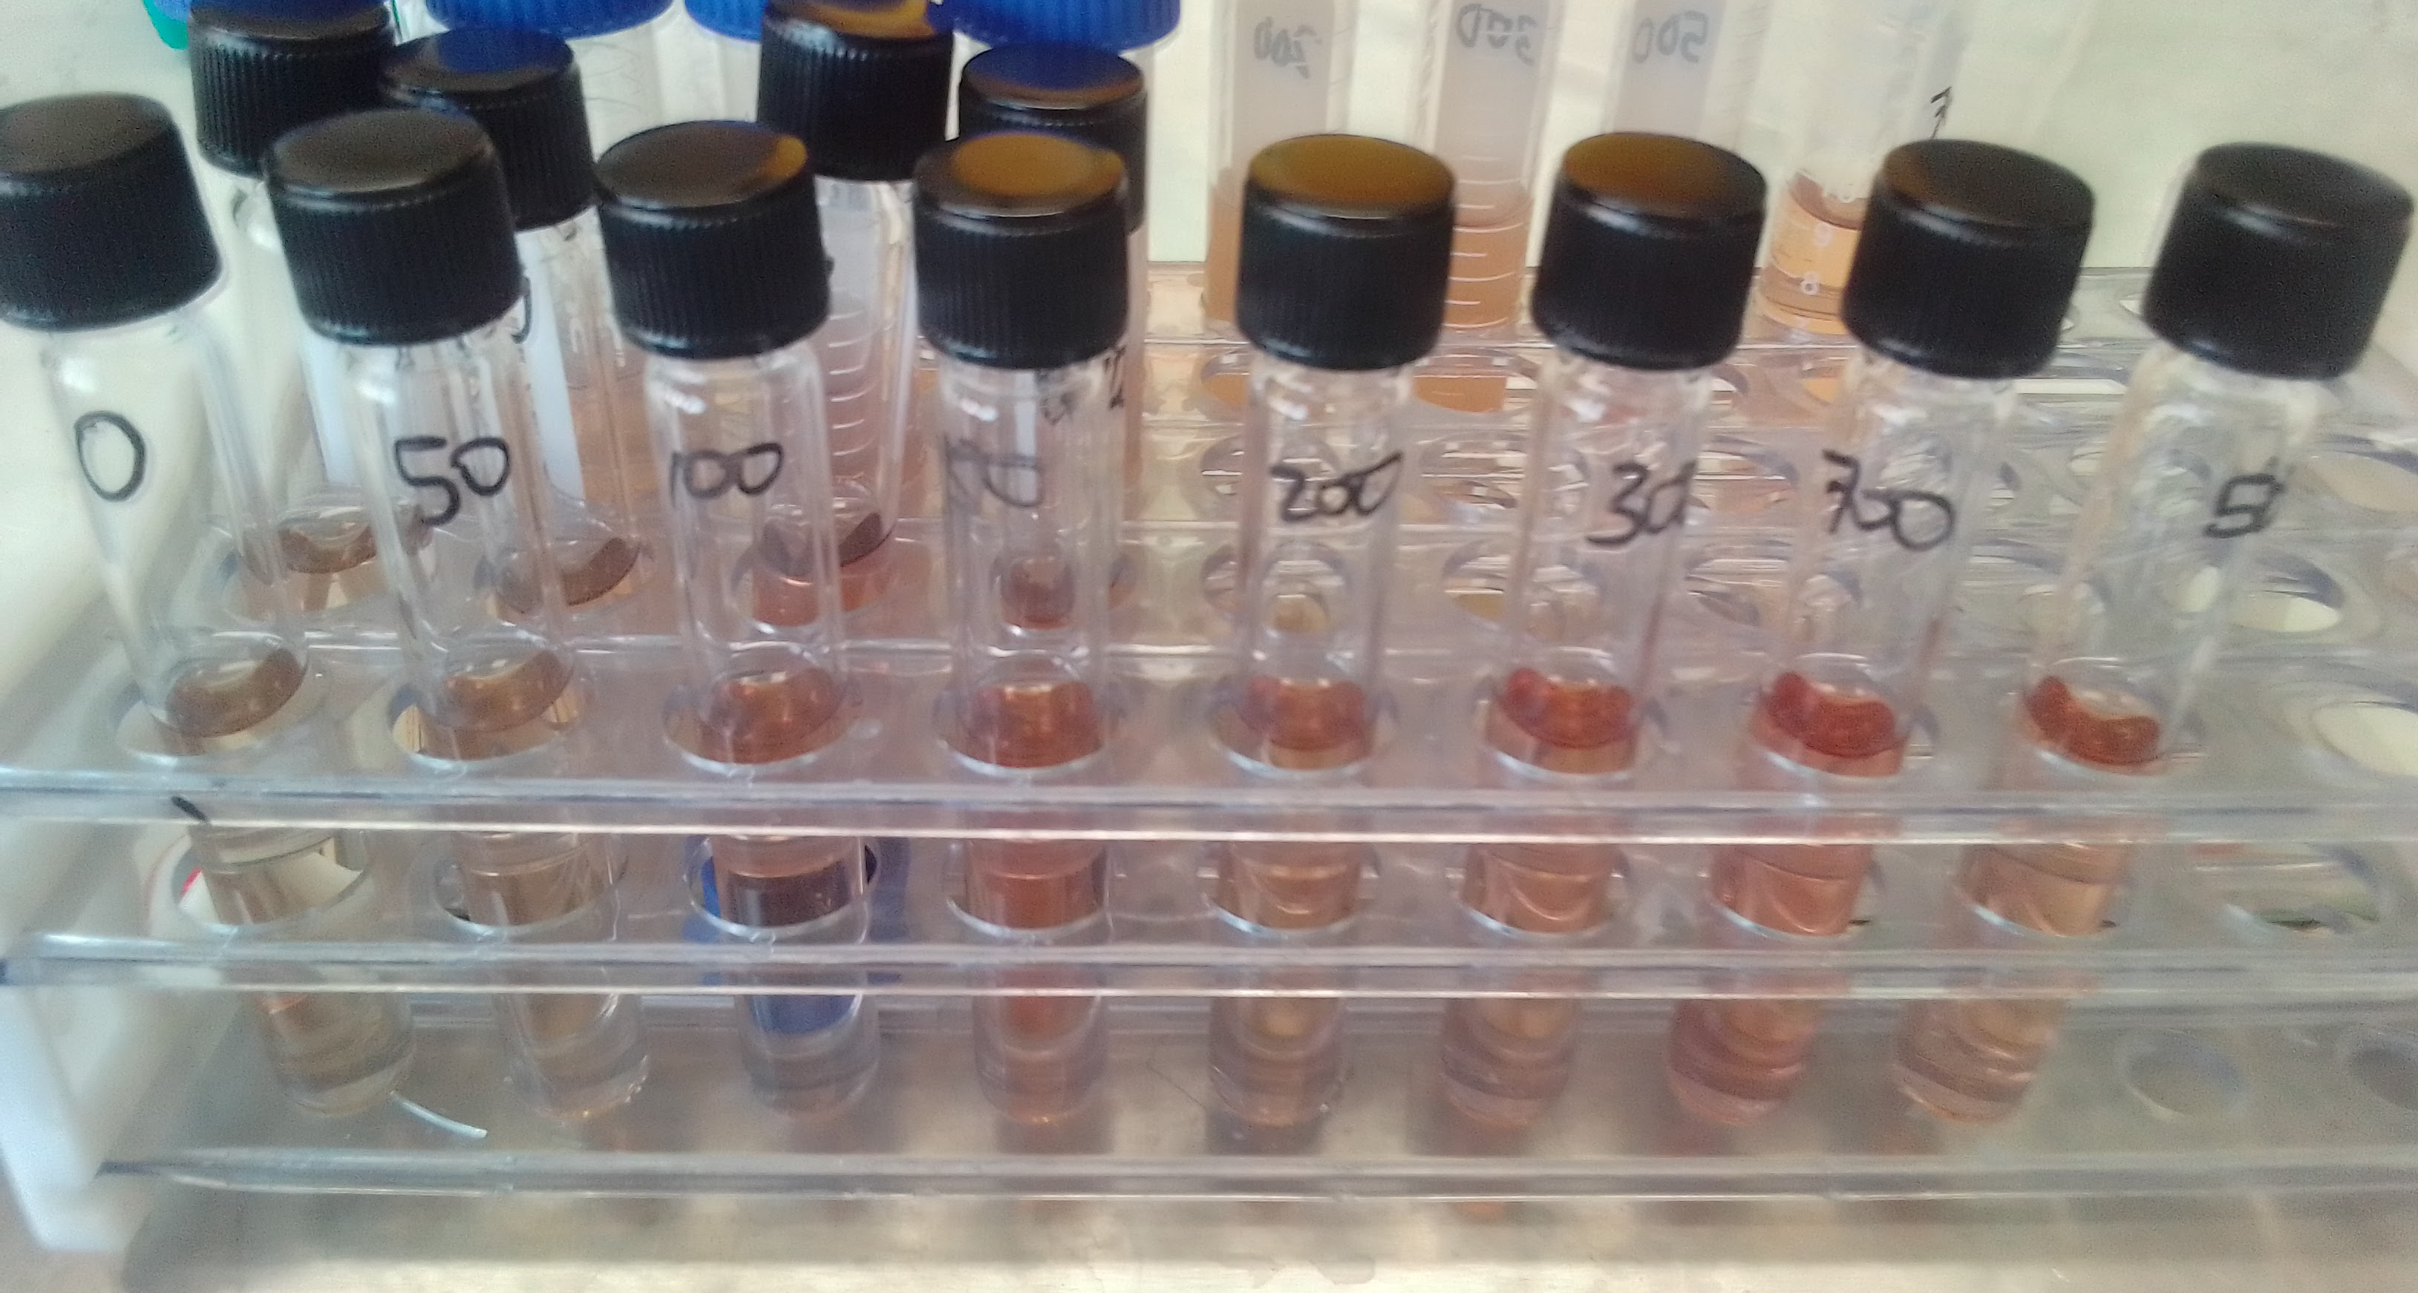
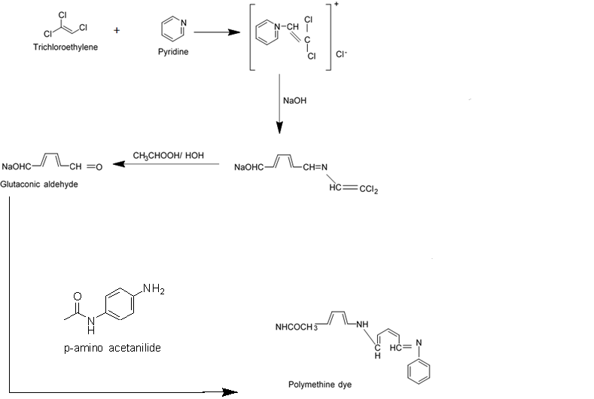
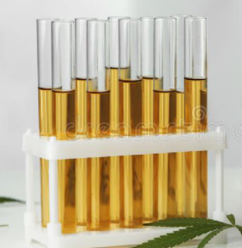
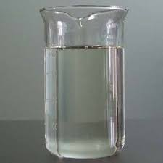
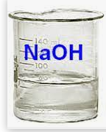
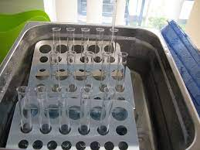
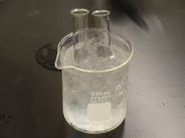
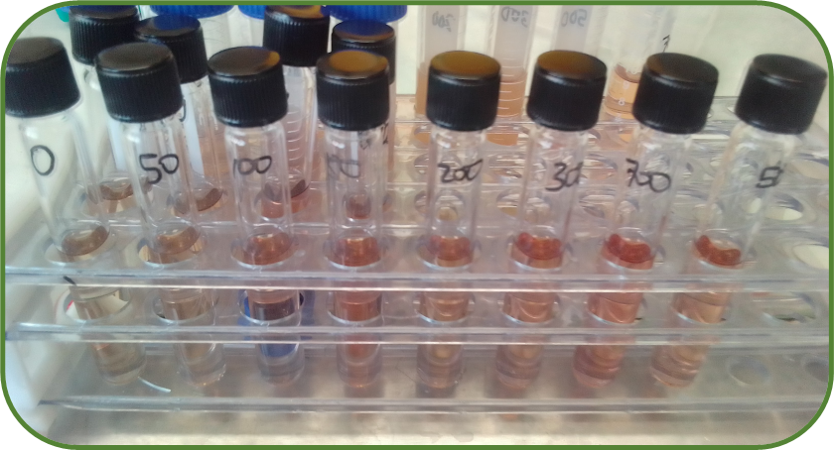
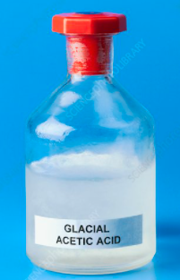
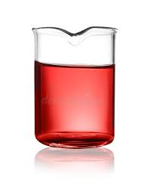
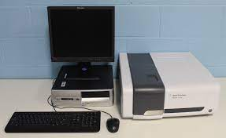
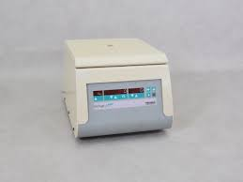
METHODOLOGY
Calibration standards (n=8)
50-700 µmol-L
Pyridine
5M NaOH
Water bath (65°C)
Ice cold water
Data analysis
Statistics: Excel, 2016
Glacial acetic acid
Agilent Cary 60 UV-Vis spectrophotometer (λ =520nm)
1% p-amino acetanilide
Centrifuge (2500 RPM)

Slide 10
RESULTS AND DISCUSSION
Acceptable criteria:
QCs: (80-110%)
QC1 target: 100 µmol/L
QC2 target: 300 µmol/L
Temp: 15 – 25 °C
Figure 4: The effect of the temperature

Slide 11
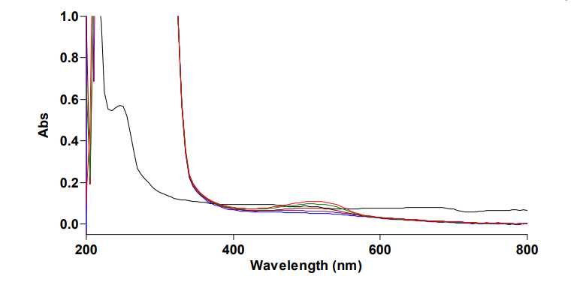
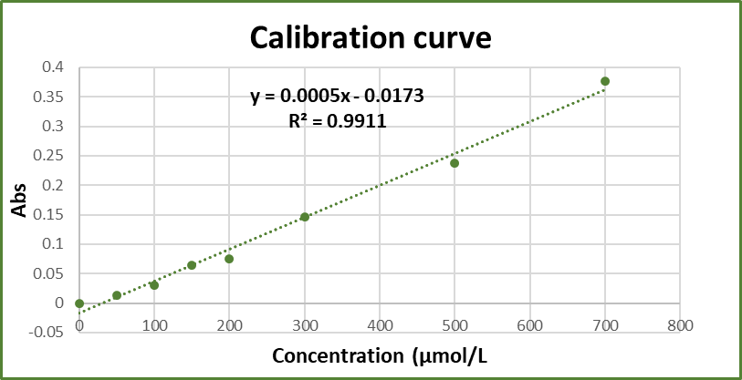
RESULTS AND DISCUSSION CONT’D
Spectral characteristics and linearity
(λ_{max} =520nm)
Figure 1: Absorption spectrum of TCE (50-700 µmol/L) at 520nm
)
Figure 2: TCE calibration curve

Slide 12
RESULTS AND DISCUSSION CONT’D
Method Validation
Analytical Figures of merit were calculated according to SOPs NIOH0391 and NIOH0371 as guided by TR 26 of SANAS
Table 1: Analytical Figures of merit
Parameters | QC1 | QC2 | Acceptable Criteria
Recovery (%) | 95.62 | 96.60 | 80-110
Precision (% RSD) | 8.06 | 8.90 | 15 (max)
LOD: 0.16 µmol/L
LOQ: 0.54 µmol/L
UoM: 16.98%
LOD: Limit of detection
LOQ: Limit of quantification
UoM: Uncertainty of measurement

Slide 13
RESULTS AND DISCUSSION CONT’D
Table 2: Comparison of TCE data from the present study with data from the other study
Author | Sample preparation | Separation and Detection | LOD (µmol/L)
Ye et al., 2017 | LLE | GC-ECD | 0.02
Monatisa, L. (2022) | LLE | Uv-VIS Spectrophometrer | 0.16
Skilled personnel to operate the instrument and process the data.
Capital intensive
Not suitable for routine analysis
GC: Gas Chromatography
ECD: Electron Capture Detector
LLE:Liquid-Liquid Extraction
LOD: Limit of detection

Slide 14
CONCLUSION
1
A simple, sensitive and rapid method was developed and validated.
2
The analytical figures of merit were all within the acceptable ranges fulfilling SOPs NIOH0391 and NIOH0371.
3
Suitable for the routine analysis for biological exposure to TCE.
4
The method can also be used for research purposes.

Slide 15
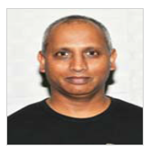
ACKNOWLEDGEMENT
Supervisors
Co-supervisors
Analytical Services

Slide 16
REFERENCES
WHO (2005) “Trichloroethylene in drinking-water,” World Health Organization .
Hansen, J. et al. (2013) “Risk of cancer among workers exposed to trichloroethylene: analysis of three Nordic cohort studies.,” Journal of the National Cancer Institute, 105(12). doi:10.1093/jnci/djt107.
Kumar, M. et al. (2009) “Study of genetic polymorphism in solvent exposed population and its correlation to in vitro effect of trichloroethylene on lymphocytes,” Journal of Environmental Biology, 30(5).
Singthong, S. et al. (2015) “Occupational health risks among trichloroethylene-exposed workers in a clock manufacturing factory,” Global journal of health science, 7(1). doi:10.5539/gjhs.v7n1p161.

Slide 17
REFERENCES
Douglas, G.A., Ikeda, M. and Nogueira, D.P. (1981) “Recommended health-based limits in occupational exposure to selected organic solvents,” World Health Organization - Technical Report Series, No.664.
Brown, S. D., Dixon, A. M., Bruckner, J. v., & Bartlett, M. G. (2003). A validated GC-MS assay for the quantitation of trichloroethylene (TCE) from drinking water. International Journal of Environmental Analytical Chemistry, 83(5). https://doi.org/10.1080/0306731031000104713
Liu, Y., Xin, Q., Liu, D., Cai, Z., Zhang, Z., Lan, J., Wei, R., Li, D., & Hou, R. (2012). The application of HS-SPME-GC/MS in detecting chemical components in giant panda (Ailuropoda melanoleuca) urine. Acta Theriologica Sinica, 32(1).
Munch, D., & Hautman, D. (1995). Method 551.1: Determination of chlorination disinfection byproducts, chlorinated solvents , and halogenated pesticides/ herbicides in drinking water by liquid-liquid extraction and gas chromatography with electron-capture detection. Environmental Protection.

Slide 18
REFERENCES
Rastkari, N., Ahmadkhaniha, R., & Yunesian, M. (2012). Simultaneous determination of trichloroethylene, perchloroethylene and trichloroacetic acid in human urine using solid-phase microextraction fibre coated with single-walled carbon nanotubes. International Journal of Environmental Analytical Chemistry, 92(14). https://doi.org/10.1080/03067319.2011.581367
Zhang, M., & Harrington, P. (2015). Determination of Trichloroethylene in Water by Liquid–Liquid Microextraction Assisted Solid Phase Microextraction. Chromatography, 2(1). https://doi.org/10.3390/chromatography2010066

Slide 19
“Your product is as good as the methods”
Ke ya Leboha

