Slide 1
Occupational Cardio-respiratory diseases in South African miners at autopsy in 2020: The First Pathology Surveillance Report within the COVID era
Ms Lucia N Mhlongo
Ms Zethembiso B Ngcobo
Dr Delerise Fassom
Dr Deepna G Lakhoo
Dr Kerry Wilson
Prof Jill Murray
30 November 2022
Healthy, Safe, Happy & Sustainable Workplaces
PROMOTING DECENT WORK THROUGH CUTTING EDGE RESEARCH, SPECIALISED SERVICES, INFORMATION, TEACHING AND TRAINING

Slide 2
INTRODUCTION AND BACKGROUND
Mining and works related dust has been recognized and well studied as the key determinant of occupational respiratory disease for many years¹.
Autopsy examinations for deceased workers from mines and works are done at the National Institute for Occupational Health (NIOH) as per Occupational Diseases in Mines and Works Act, of 1973 (ODMWA Act 78 of 1973) for compensation purposes.
Autopsy findings, demographic data, occupational histories are captured and stored in an electronic dataset, PATHAUT, since 1975, this data is used for surveillance and research purposes⁴.
Detailed pathology annual reports from 1975 are available on the NIOH website; https://www.nioh.ac.za/pathology-disease-surveillance-reports/.

Slide 3
AIMS AND OBJECTIVES
Aim:
To describe occupational cardio-respiratory diseases in South African miners at autopsy in 2020.
Objectives:
Report trends in occupational respiratory disease.
To describe the distribution of age, commodity and employment duration in the disease outcomes.

Slide 4
MATERIALS AND METHODS
Full autopsy examinations were done on 14 deceased workers and cardio-respiratory pathology examinations on 543 workers in 2020.
Full autopsies are mainly done on workers who die within Johannesburg while cardio-respiratory organs are removed by trained local prosectors and sent to the NIOH from all provinces.
Histotechniques, and light and electron microscopy are the main techniques used for identifying disease and pathology in the organs.
The data for this analysis was retrieved from PATHAUT and analysed using basic descriptive statistics in SAS Enterprise Guide v 7.1 and the graphs were drawn in Excel.

Slide 5
DEMOGRAPHICS
TABLE 1: DEMOGRAPHIC DATA FOR CASES RECEIVED IN 2020
DEMOGRAPHICS | 2020 N (%) 557 | DEMOGRAPHICS | 2020 N (%) 557
Mean age (years) | 62
Province Eastern Cape Free State Gauteng KwaZulu-Natal Limpopo Mpumalanga Northern Cape North West Western Cape | 7(1) 145(20) 195(27) 6(1) 10(2) 32(6) 93(17) 241(33) 6(1) | Commodity * Gold Platinum Asbestos Coal | 335(65) 82 (16) 69(13) 34(5)
Gender Female Male | 29(5) 528(95) | Race Black White | 304(55) 251(45)
Employment Status Current Ex-miner | 187(35) 348(65)
* Commodity grouped as per longest service
Notes:
The mean age at autopsy of black miners was 55 years
The mean age of white miners at autopsy was 70 years

Slide 6
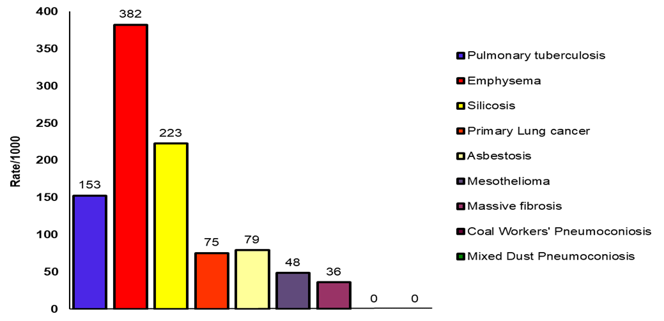
PATHOLOGICAL FINDINGS
FIGURE 1: OVERALL DISEASE RATES PER 1000
* Miners may have more than one disease

Slide 7
PATHOLOGICAL FINDINGS
PULMONARY TB
15.3% of cases were diagnosed with active pulmonary TB (PTB).
The majority of the TB cases (65%) were in black miners.
Majority of the PTB had gold (67%) and platinum (15%) exposure.
The overall rate of PTB was 153/1000 in 2020 compared to 192/1000 in 2019, this is a decrease, and an encouraging trend.

Slide 8
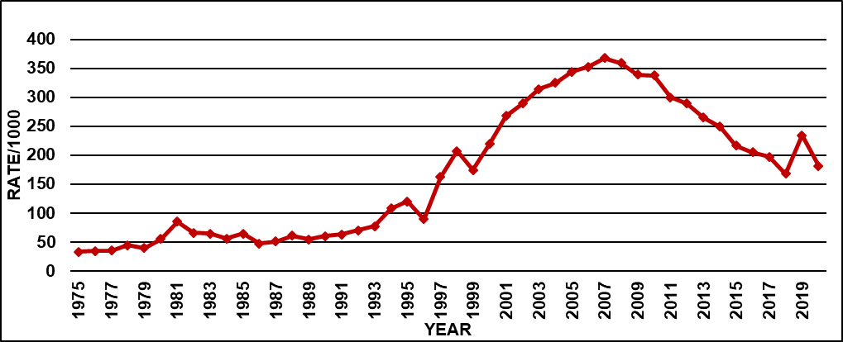
PULMONARY TB CONTINUED
FIGURE 2: ACTIVE PTB RATES IN BLACK MINERS AT AUTOPSY (1975-2020)

Slide 9
SILICOSIS
Silicotic nodules were identified in the lungs of 22% of all autopsies.
Majority of the cases (87%) had worked in gold mining.
Large silicotic nodules were found in 16% cases.
3.6% of cases had massive fibrosis, and 90% were from the gold mining industry.
The overall rate of silicosis in 2020 was 223/1000 compared to 246/100 in 2019, this indicates a decrease after the 2019 increase.
The overall rate of massive fibrosis was 36/1000 in 2020, a decrease from 2019 at 41/1000.

Slide 10
SILICOSIS
FIGURE 3: SILICOSIS IN BLACK GOLD MINERS AT AUTOPSY (1975-2020)

Slide 11
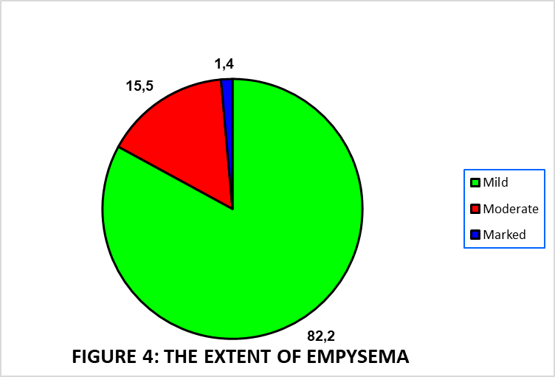
EMPHYSEMA
Emphysema remains a commonly diagnosed respiratory disease at autopsy (38%).
The rate of emphysema increased in 2020.

Slide 12
ASBESTOS-RELATED DISEASES
Forty-four (8%) cases of asbestosis were diagnosed. 82% of these workers had worked in the asbestos mining industry and 7% had environmental asbestos exposure.
Twenty-seven of the cases were mesothelioma.
The rate of asbestosis and mesothelioma increased in 2020.
PRIMARY LUNG CANCER
There were forty-two (8%) cases of primary lung cancer in 2020.
40.5% in black miners and 60% in white miners.
Most cases (67%) came from the gold mining industry although the highest rate was from the asbestos mining industry.
Overall, the rate of lung cancer increased in 2020.

Slide 13
AUTOPSY FINDINGS IN WOMEN
History of occupational exposure was noted in 86%.
Majority had a history of working in the asbestos industry 55%, 17% in ‘other mining sectors, and 14% in the gold industry. The remainder had environmental asbestos exposure (14%).
Pulmonary TB, mesothelioma, and asbestosis remained the most common occupational diseases in women between 2019 and 2020.

Slide 14
DISCUSSION AND CONCLUSION
In 2020, there was a 26% decrease in the number of cases received, possibly due to COVID-19.
Overall most occupational respiratory diseases decreased in 2020 but levels remain a cause for concern.
The most common commodities associated with disease/s were gold and asbestos mining.
Differences in race seen may be attributed to the historical bias in referral, access and awareness.
The COVID pandemic does not seem to have altered the trends and rates of occupational cardio-respiratory diseases in 2020.

Slide 15
REFERENCES
1. Ross MH, Murray J. Occupational respiratory disease in mining. Occup Med (Lond). 2004 Aug;54(5):304-10. doi: 10.1093/occmed/kqh073. PMID: 15289586.
2. South Africa, Department of Health. Occupational Disease in Mines and Works Act, 1973 (Act N0. 78 of 1973). Government Printer: Pretoria;1973.
3. Murray J , Davies T, Rees D. Occupational lung disease in the South African mining industry: Research and policy implementation. Journal of Public Health Policy 32 Suppl. 2011; 1(1):S65-79. DOI:10.1057/jphp.2011.25.
4. Ndlovu N, Nelson G, Vorajee N, Murray J. 38 years of autopsy findings in South African mine workers. Am J Ind Med. 2016; 59(4):307-314. https://doi.org/10.1002/ajim.225745.
5. Hessel PA, Hnizdo E, Goldstein B, Sluis-Cremer GK. Pathological findings in mine workers: II. Quality of the PATHAUT data. Am J Ind Med. 1987; 12: 819

Slide 16
THANK YOU
QUESTIONS

Slide 17
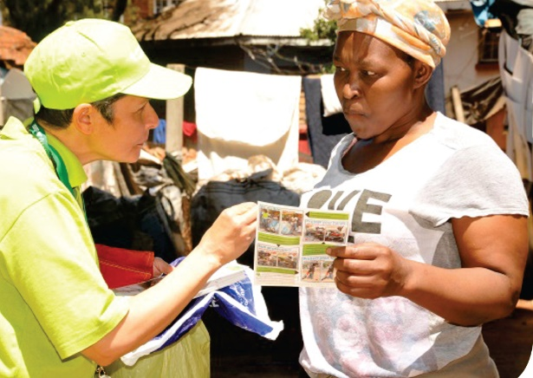
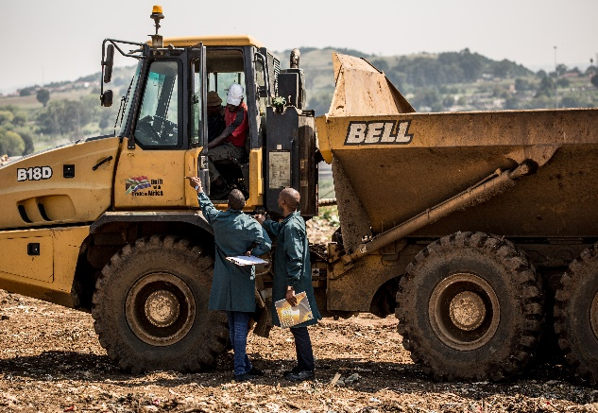
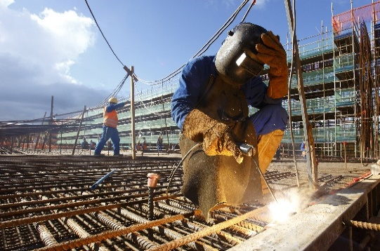
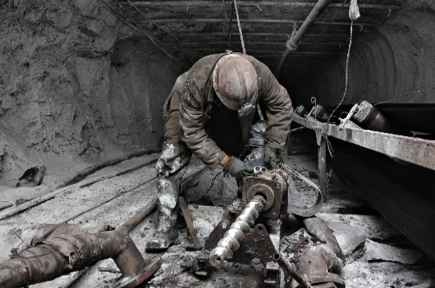
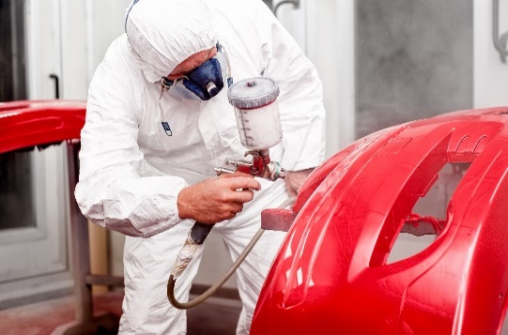
Healthy, Safe, Happy & Sustainable Workplaces WWW.NIOH.AC.ZA | TWITTER: @NIOH_SA | INFO@NIOH.NHLS.AC.ZA

